Slide 1

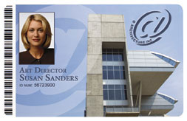
Establishing Identification
Click on sound
Lesson Three
Notes:
Welcome back. In Lesson one, we talked about the services of a bank. In lesson two, we looked at the anatomy of a check by identifying its different parts. In this lesson, we are going to look at establishing identification.

Slide 2

Act of Identifying a person
A method of identifying an individual
A result of remembering…
Notes:
Identification is required when applying for a job, opening up a new account, obtaining a credit card, or even retrieving money from your existing bank account. Many establishments such as a bar or a club may require identification to gain admittance.

Slide 3
What is Identification?
Generally, something that identifies a person
A certifying document that proves the bearer’s identity

Slide 4
Types of acceptable forms of ID
Primary Forms
Driver’s Licenses
Passport (book / card)
U. S. Military
Resident Alien Card (Green Card)
Employer issued *
Notes:
Here is a list of the most common forms of acceptable ID. These are referred to as primary forms because they are most widely accepted. They all have a photograph of the bearer and each of them, with the exception of an employer issued ID, will have an expiration date. Following on the next few slides, we will look at some examples.

Slide 5
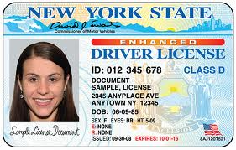
Sample Driver’s License
Upon receipt:
Carefully inspect ID
Verify:
  Photo likeness
  ID number
  Signature
  Expiration date
Notes:
Here is an example of a state-issued driver’s licenses. When presented, you must inspect the card to ensure it is valid. You want to ensure that the person in front of you has some likeness to the photo on the card, it has a signature, and it has not expired.

Slide 6
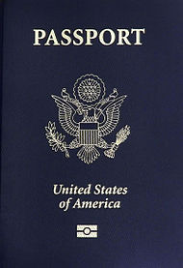
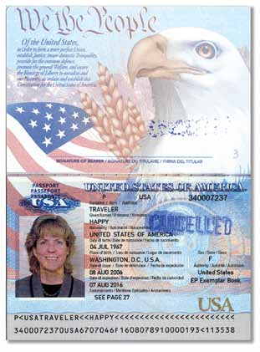
Sample Passport (book)
Notes:
A passport is an acceptable form of identification. Here we have a U. S. passport that is issued by the federal government. In this example on the left, we are looking at the book version with the familiar blue cover and silver imprinting. On the right is the inside cover and details of the bearer such as name, date of birth, date of issue, passport number, and expiration date. Passports from foreign countries are also acceptable. You follow the same process in verifying the identity of the bearer.

Slide 7
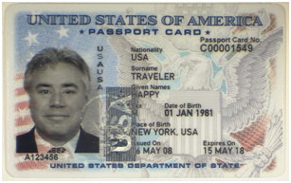
Passport Card
Notes:
Here is a sample U. S. passport card issued by the federal government. It is about the size of a credit card and has details of the bearer such as name, date of birth, date of issue, passport card number, place of birth, and expiration date. You follow the same process in verifying the identity of the bearer.

Slide 8
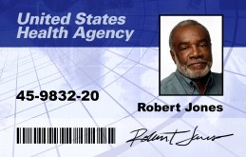
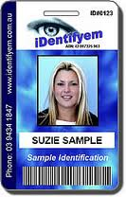
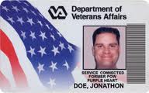
Examples of Employer IDs
Notes:
Most employers and industries issue identity cards to their employees. Here are three examples of an employer issued ID card. Notice that all three of them have a photograph of the employee. You will also note that there is no expiration date on any of these cards.

Slide 9
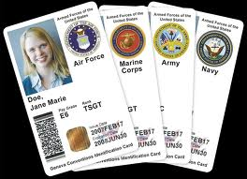
Sample U. S. Military (Armed Forces) ID
Notes:
Members of the active U. S. Armed Forces are issued an ID card. The logo from each branch of service appears in the upper right of the card parallel to the bearer’s photograph. Other forms are also issued for retired military members and their dependents.

Slide 10
Secondary forms of identification
Credit Cards (i.e., MasterCard, Visa)
School issued ID (high school, universities)
Public Library Card
Notes:
Earlier we looked at the primary forms of identification. There are also secondary forms of ID that are used to establish a person. Secondary forms of IDs are limited as most do not have a photograph. They can be used as a supplemental form to verify a signature, a name, or on an account.

Slide 11
Summary
Identification is something that identifies a person
It proves its bearer’s identity
There are primary and secondary forms of ID
Establish authenticity of both the document and the bearer
Notes:
This completes our lesson on establishing identification. In this lesson we identified both primary and secondary types of identification and looked at some examples. Remember, identification is something that identifies a person and it proves the bearer’s identity.

